Slide 1
Hotel Management Database System
Mohammed Sayed
Ashlesha Donde
Shivani Sugurushetty Pranav Waghmare
Meghana Thota
Zhichao Dai
Prof. Manuel Montrond

Slide 2
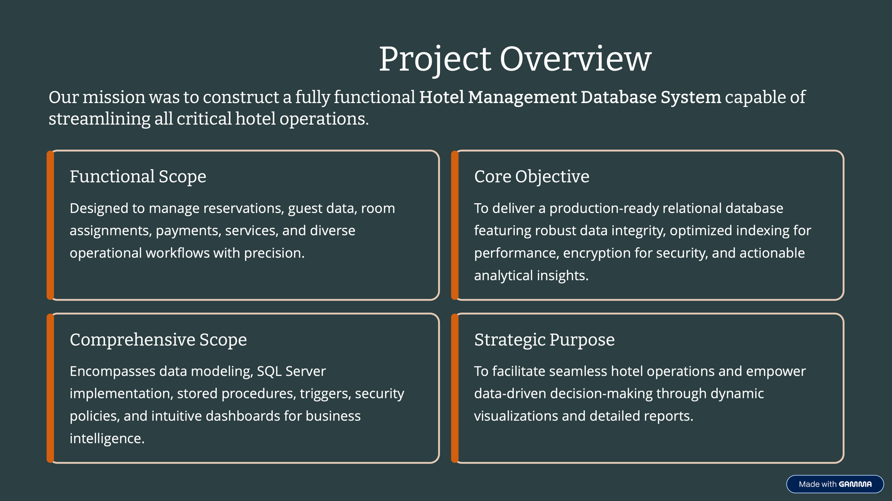

Slide 3

Logical Entity Relationship Diagram (ERD):

Slide 4
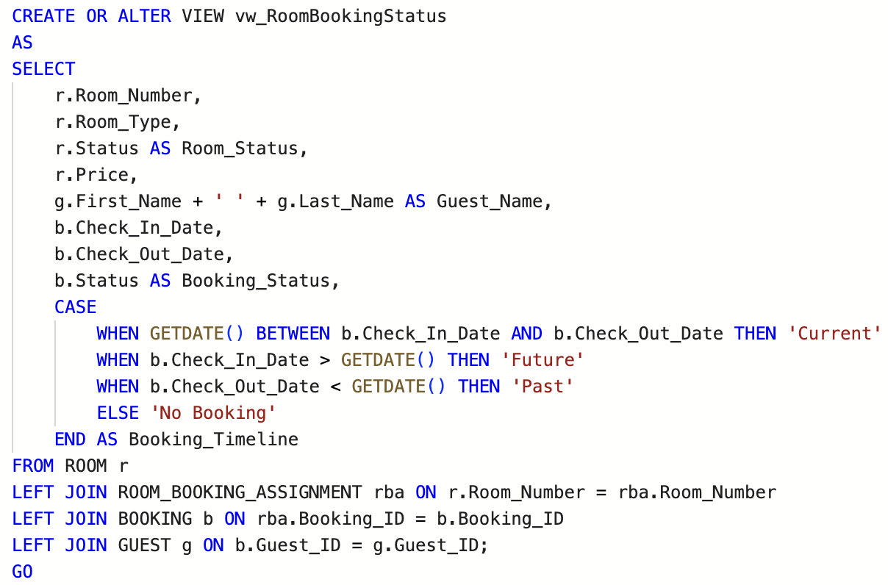
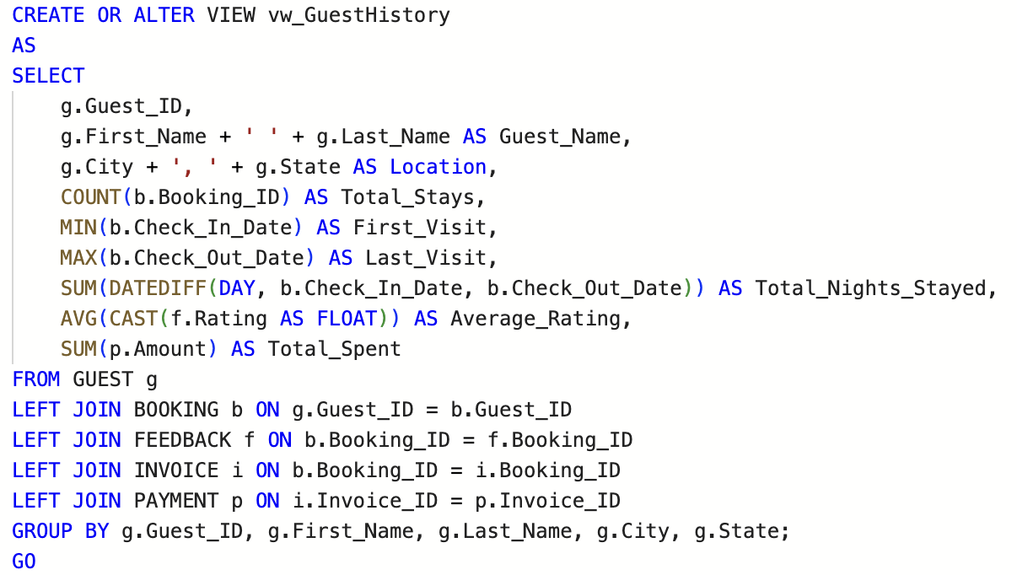
Data Objects
View
Created views like vw_RevenueReport, vw_GuestHistory, vw_DailyOperations and vw_RoomBookingStatus to simplify reporting and analytics queries.
Shows each room along with its booking details and the guest staying in it.
Indicates whether the room’s stay is current, upcoming, or completed.
Useful for quickly checking room occupancy and availability.
Summarizes a guest’s full stay history, including number of stays, nights stayed, ratings, and total spending.
Helps identify loyal or high-value customers for personalized service.

Slide 5
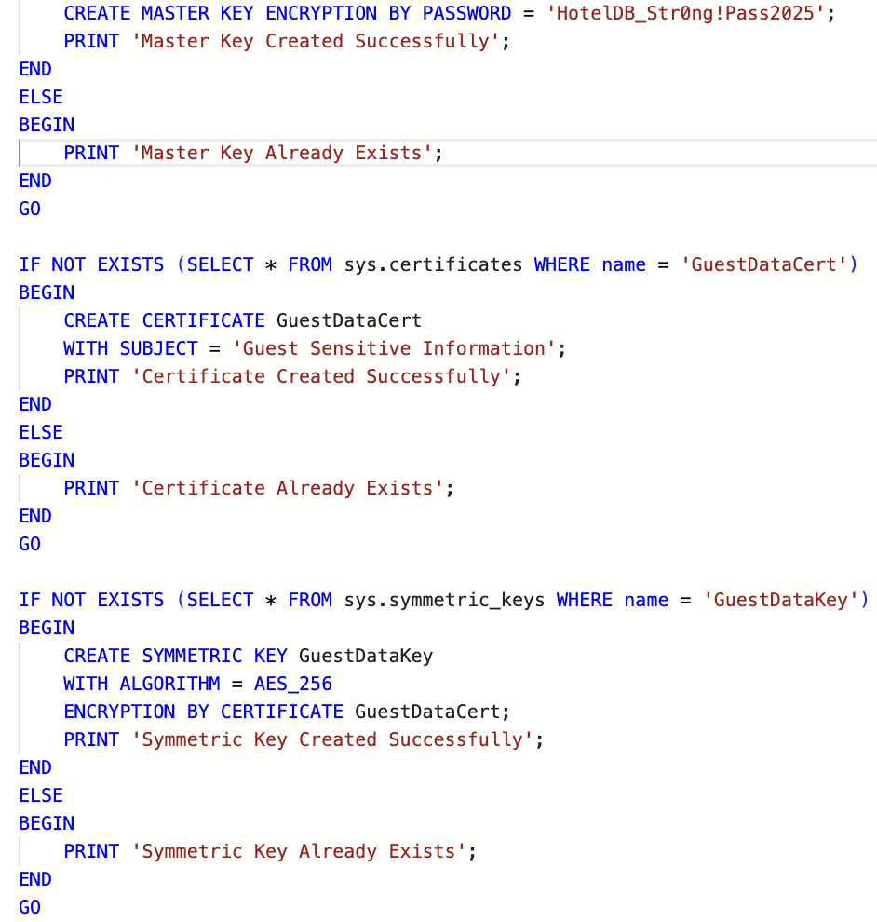
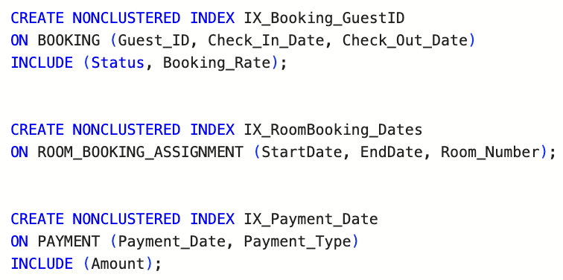
Data Objects
Encryption:
Non- clustered index:
A non-clustered index creates a separate lookup structure that makes searching faster without changing the table’s physical order.
We used it to speed up frequent queries on bookings, payments, room availability, and service transactions.
Indexes reduce the amount of data SQL Server scans, improving performance and lowering query cost (EstimatedTotalSubtreeCost).
This makes the system more efficient and responsive, especially for reports, filters, and real-time operations.
Implemented AES-256 encryption using a Master Key, Certificate, and Symmetric Key to secure sensitive guest data.
Guest PII (phone, email, address) is stored in encrypted form and handled automatically through triggers.
Prevents unauthorized access and ensures guest privacy even at the database level.
Strengthens security and makes the system more realistic and production-ready.

Slide 6
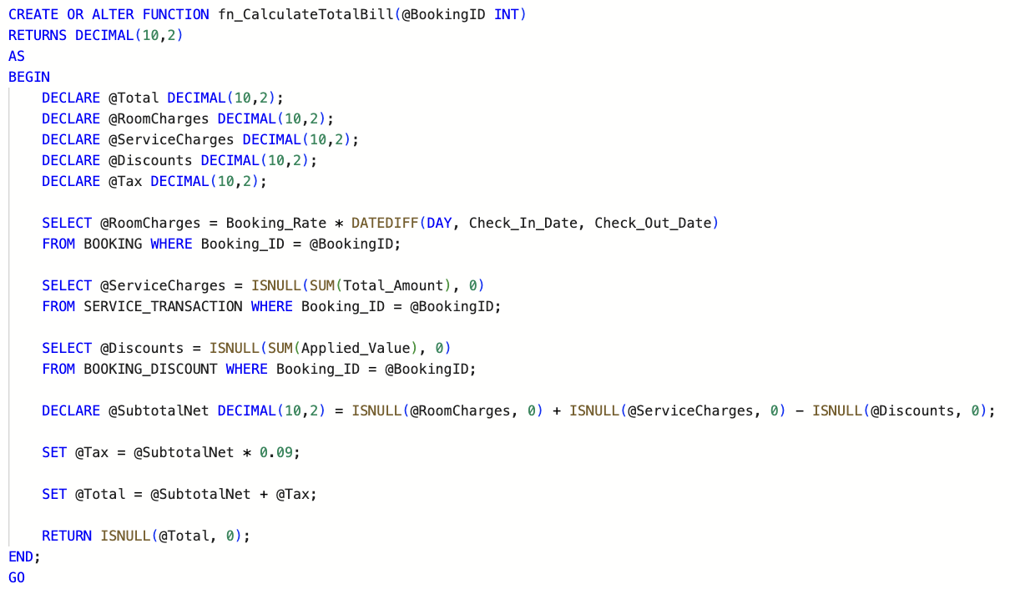
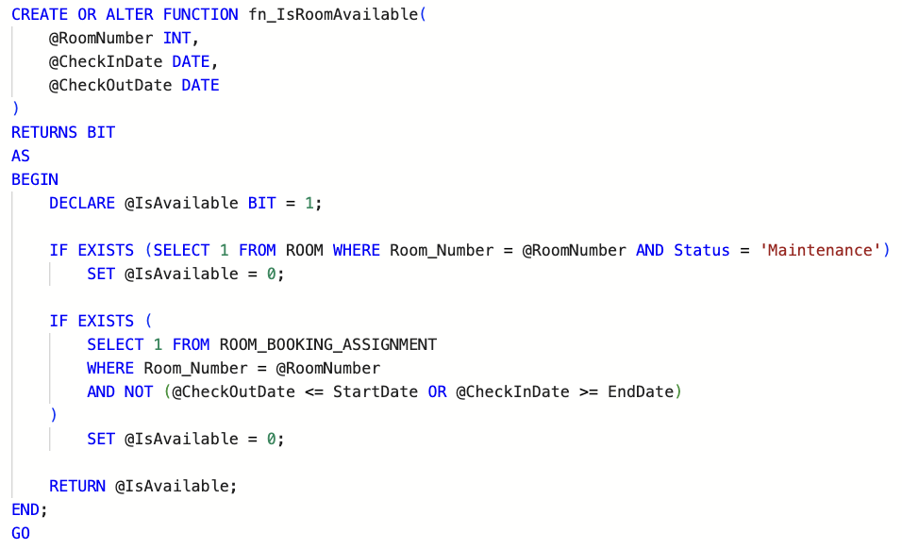
Data Objects
User defined functions:
Created functions like fn_CalculateTotalBill, fn_IsRoomAvailable, fn_GetStayDuration, and fn_GetOccupancyRate to support reusable
business logic and automate key hotel operations.
Calculates the complete bill for a booking, including room charges, service charges, discounts, and tax.
Ensures consistent and error-free billing across check-out operations.
Used inside sp_CheckOutGuest to generate final invoice amounts.
Checks if a room is free for the selected date range.
Verifies maintenance status and overlapping bookings.
Supports reservation functions by preventing double-booking.

Slide 7
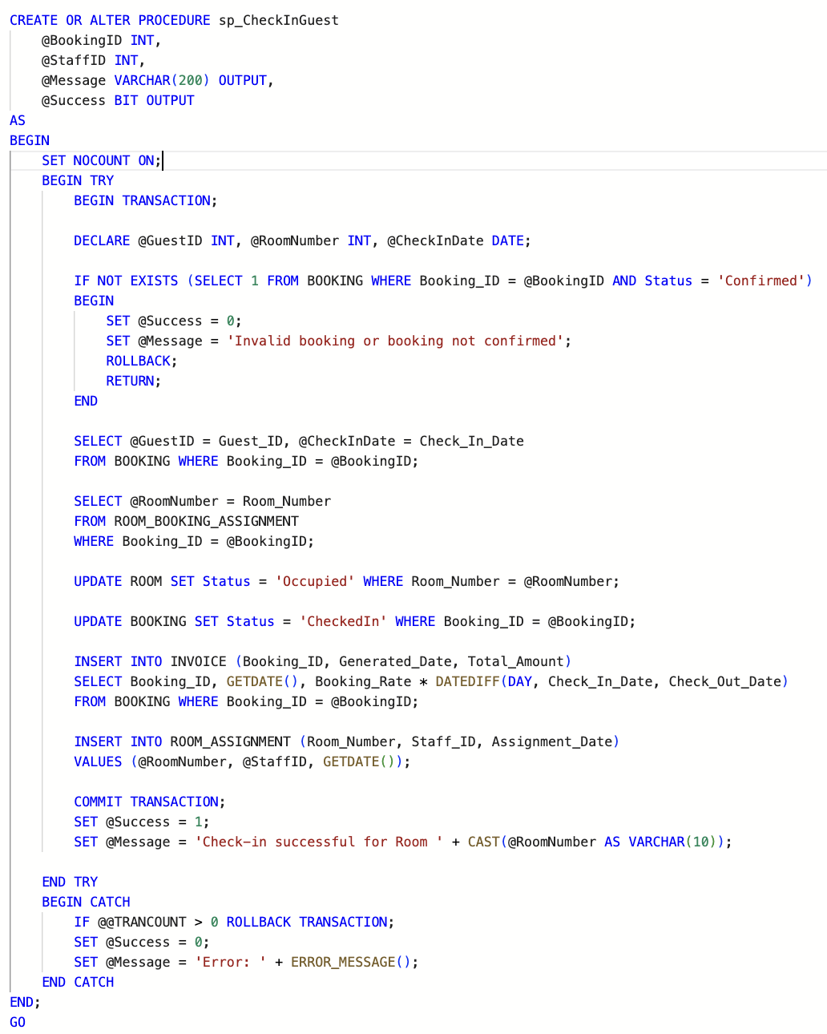
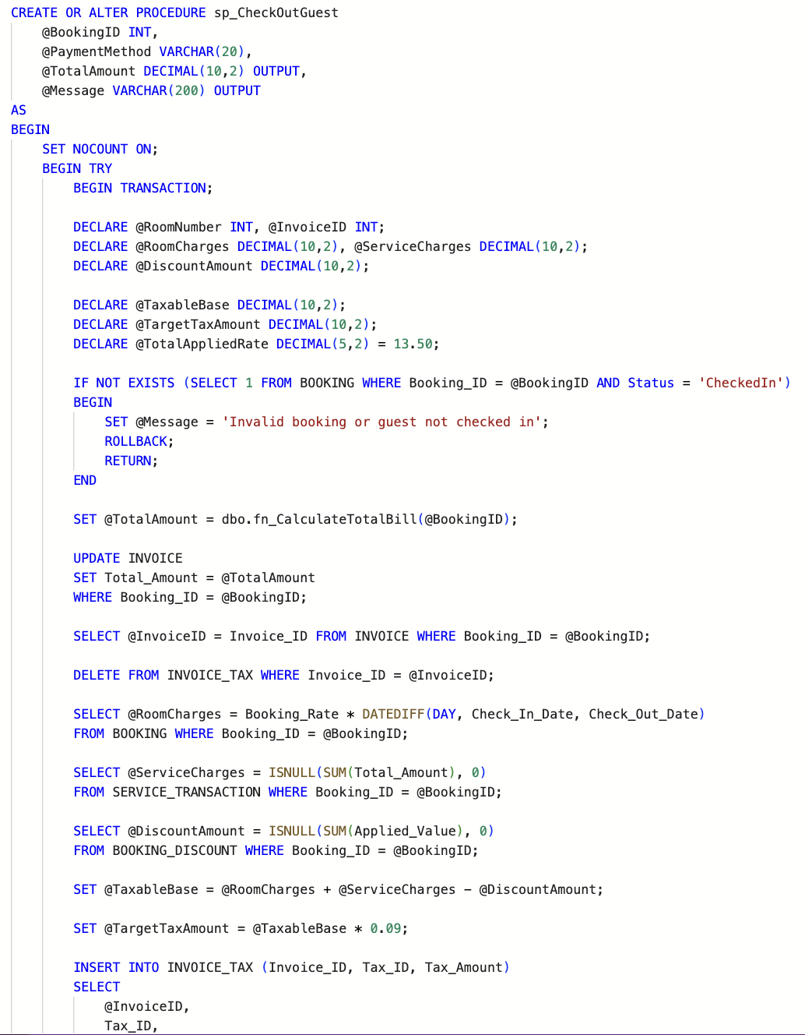
Data objects
Stored Procedures:
Created 5 stored procedures like sp_CheckInGuest, sp_CheckOutGuest, sp_FindAvailableRooms, sp_MakeReservation, and sp_ProcessMonthlyBilling to automate core hotel workflows and enforce business logic.
sp_CheckInGuest – Updates room and booking status, creates invoice, and completes the check-in process.
sp_CheckOutGuest – Calculates final bill, processes payment, and frees the room.
sp_FindAvailableRooms – Returns rooms not booked or under maintenance for given dates.
sp_MakeReservation – Creates a reservation and ensures no double-booking.
sp_ProcessMonthlyBilling – Generates month-end revenue summaries.

Slide 8
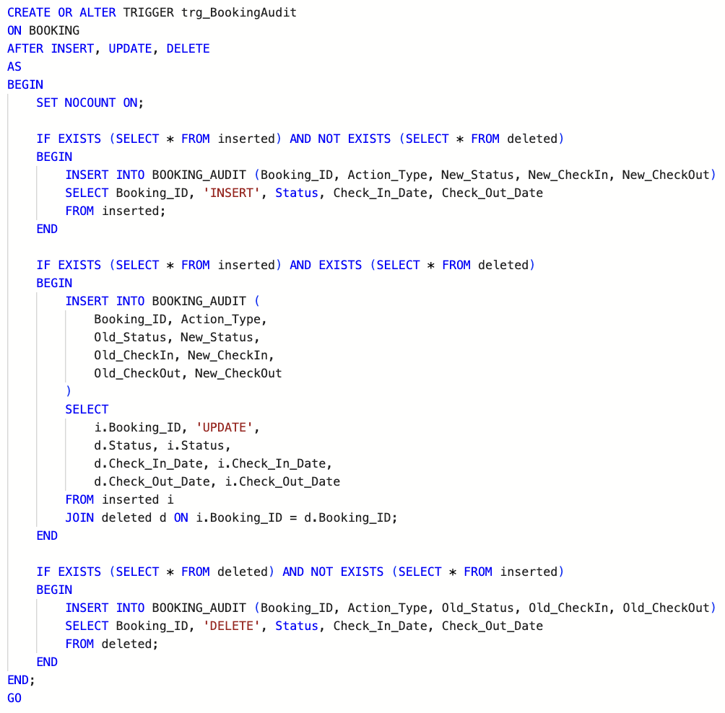
Data objects
Triggers:
Implemented triggers like trg_BookingAudit, trg_ValidatePayment, trg_UpdateRoomStatus, and trg_AutoEncryptGuest to enforce business rules and maintain data integrity automatically.
trg_BookingAudit – Logs every INSERT, UPDATE, or DELETE on the Booking table for traceability.
trg_ValidatePayment – Ensures payment amounts match the invoice total before allowing insertion.
trg_UpdateRoomStatus – Updates room availability automatically when bookings or maintenance change.
trg_AutoEncryptGuest – Encrypts guest PII fields automatically on insert or update.

Slide 9
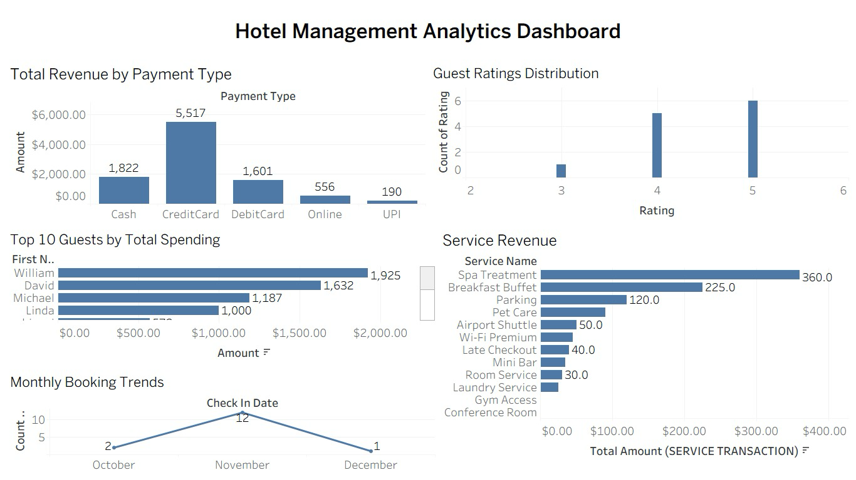
Tableau Report

Slide 10
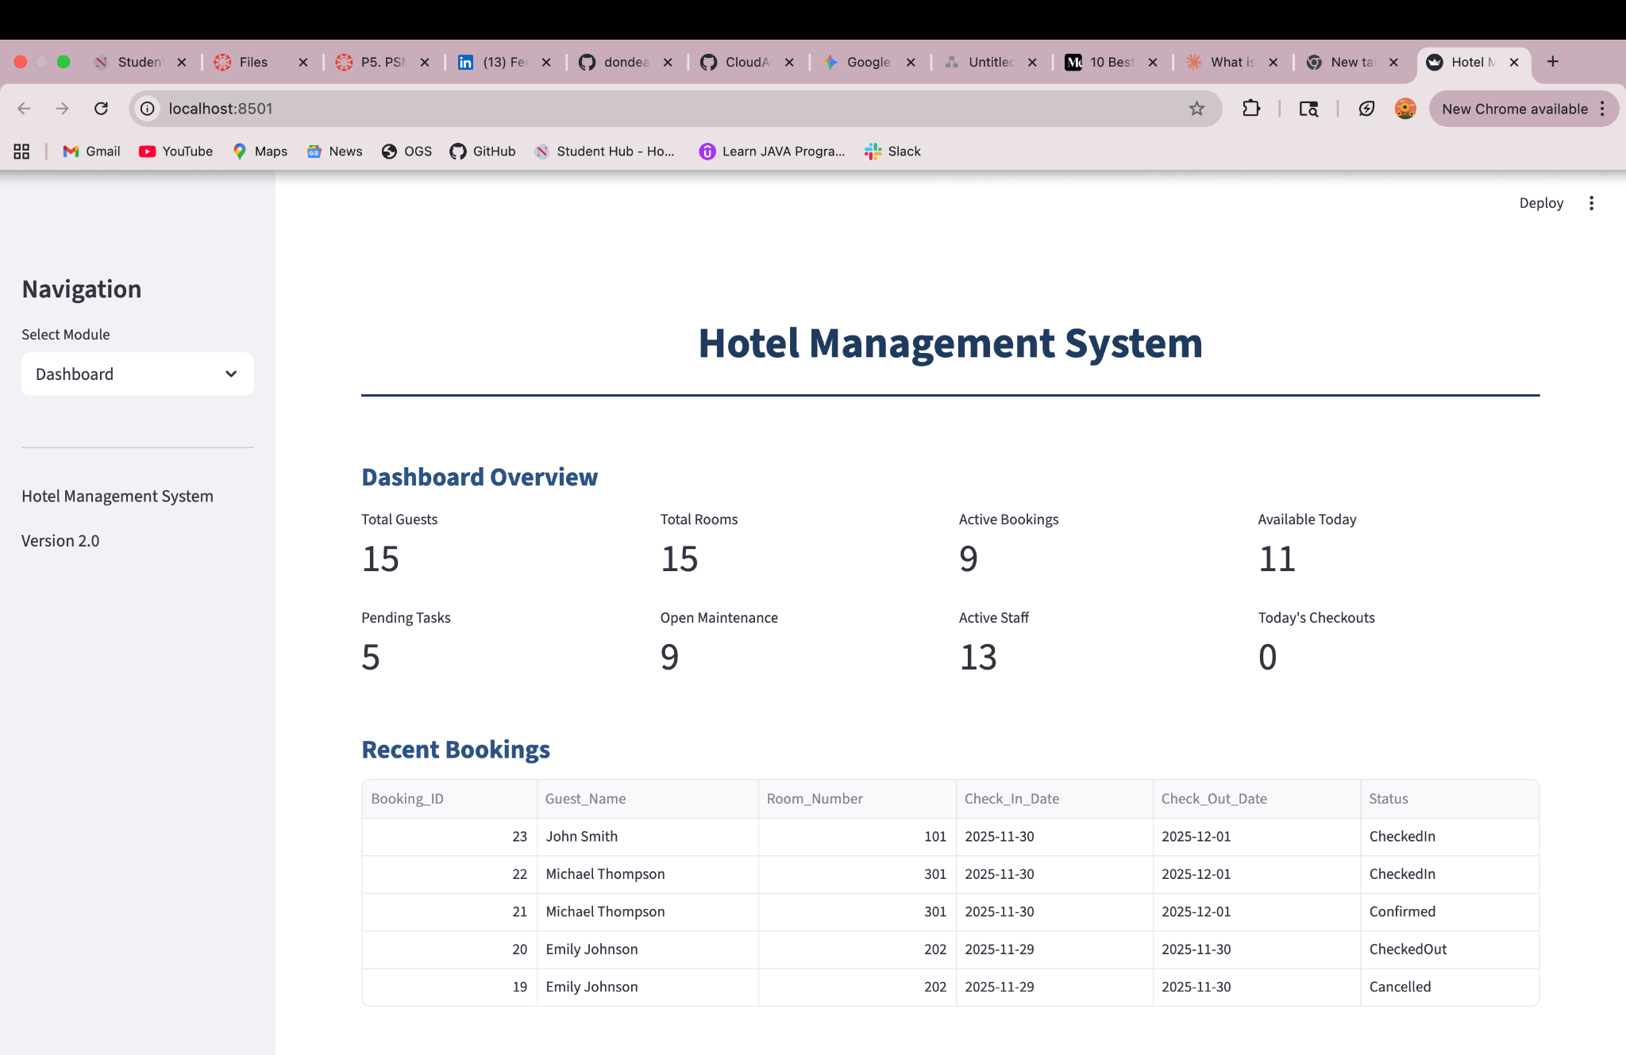
GUI

